Slide 1
Checkers
By Patrick and Sid

Slide 2
Project’s Tools
Visual Studio Code: main programming interface
GitHub / Git: sync changes across computers
External websites such as Stack Overflow for guidance on issues
Notes:
Sid

Slide 3
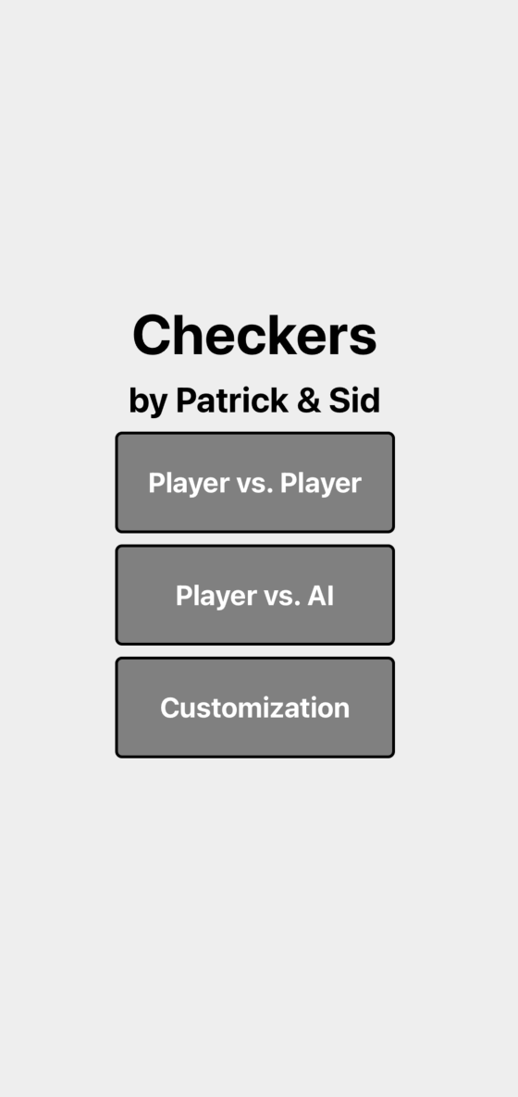
Home Screen
Allows user to pick between the two
different game modes, as well as go to
the customization screen.
Notes:
Patrick

Slide 4
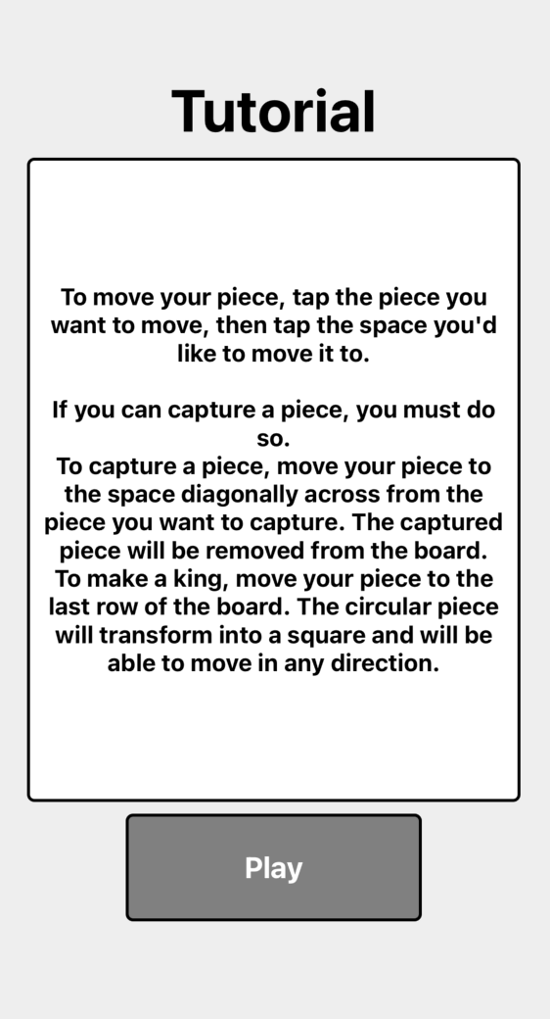
Tutorial Screen
The first time a player selects a
Checkers gamemode, a tutorial screen
pops up, informing the player of
the basic rules of the game.
Notes:
Sid

Slide 5
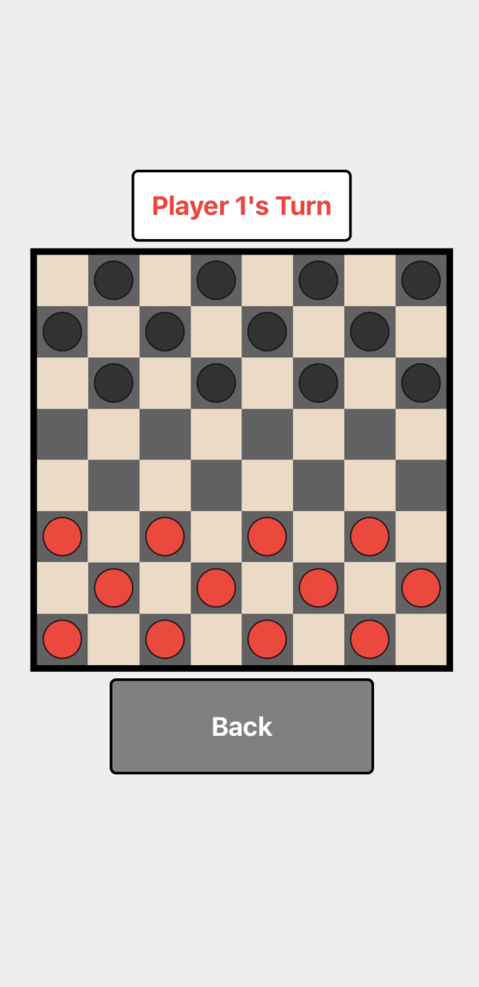
Checkers Screen (Player vs. Player or AI)
Player 1 selects their piece and where to move it to, and
the game moves their piece from there.
If the mode is Player vs. Player, Player 2 selects their piece
and where to move it to, just like Player 1.
If the mode is Player vs. AI, the AI will automatically
make a move after a short amount of time.
Notes:
Patrick

Slide 6
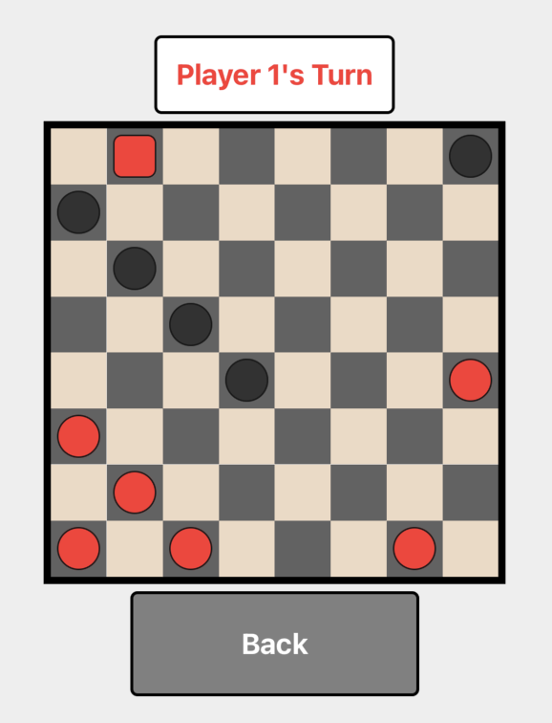
Checkers Screen (Player vs. Player or AI) - cont.
Once a player reaches the opposite side of
their board, their piece transforms into a
square piece, becoming a “King” piece.
King pieces can move in any direction
diagonally.
Notes:
Sid

Slide 7
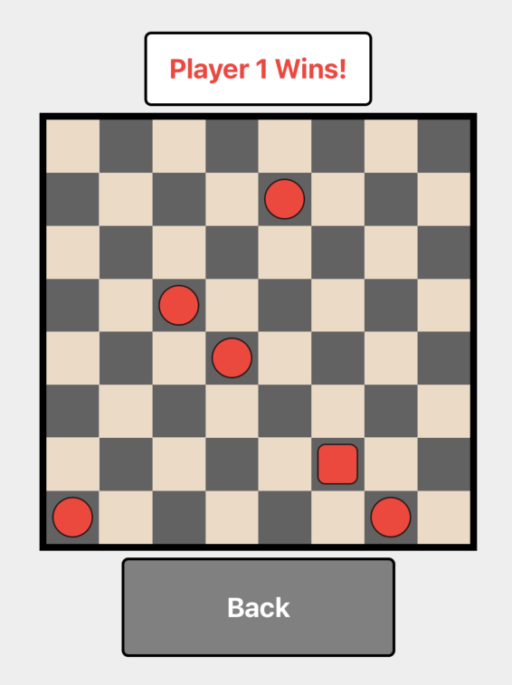
Checkers Screen (Player vs. Player or AI) - cont.
Once a player’s opponent has no valid
moves left (due to no pieces on the board
or being blocked), the player wins!
No further moves can be made.
Notes:
Patrick

Slide 8
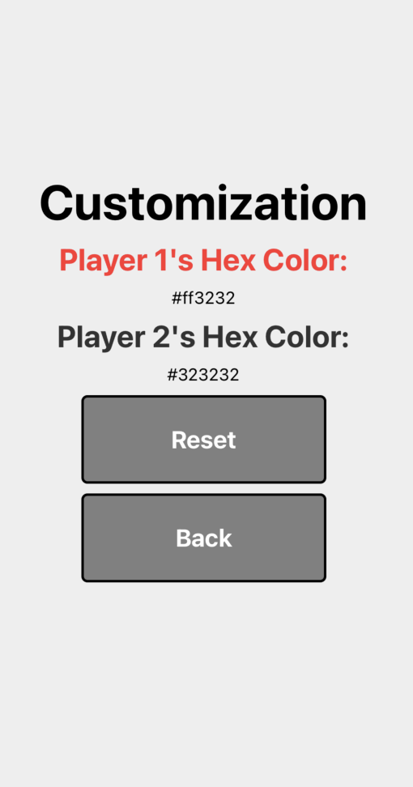
Customization Screen
Simple color customization screen, allowing the user to set (and reset) the hex color code of the pieces.
Notes:
Sid

Slide 9
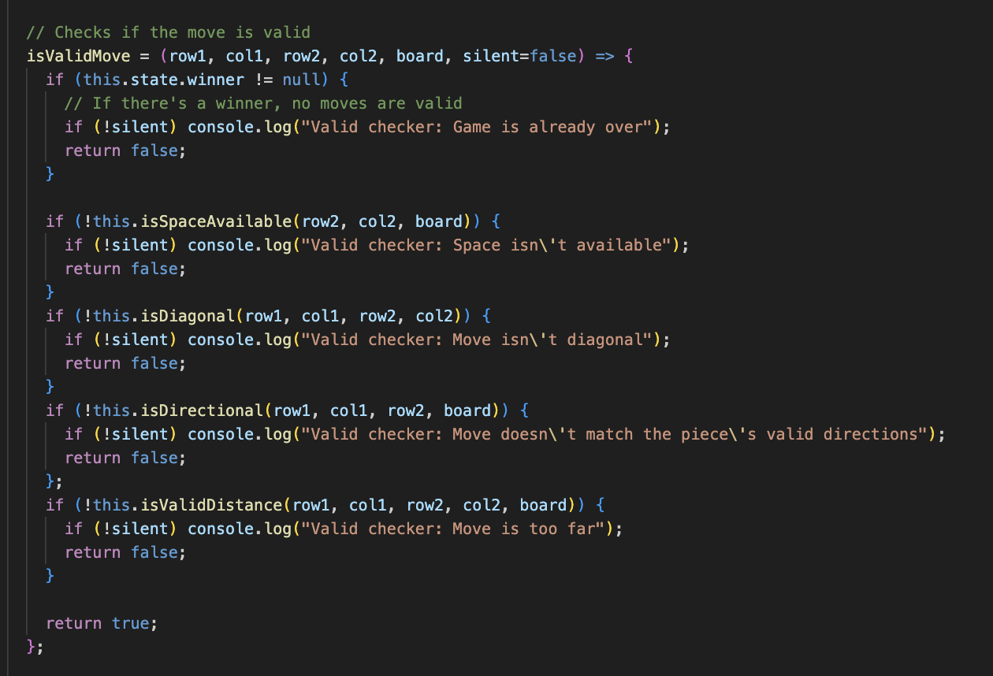
Function Highlight: isValidMove
This function helps the game determine if the user’s inputted move is valid.
It uses several helper functions that will be shown in the next slide.
Notes:
Sid

Slide 10
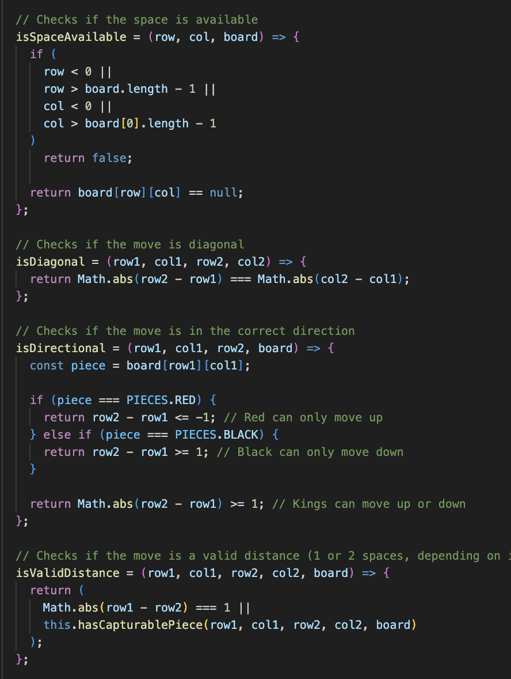
Function Highlight: isValidMove - cont.
isSpaceAvailable: checks if the space is available in the first place
isDiagonal: checks if the move is diagonal
isDirectional: check if the move matches the piece’s direction (red up, black down, king both)
isValidDistance: checks if the move is a valid distance (1 piece diagonally normally, 2 pieces diagonally if capture)
Notes:
Sid

Slide 11
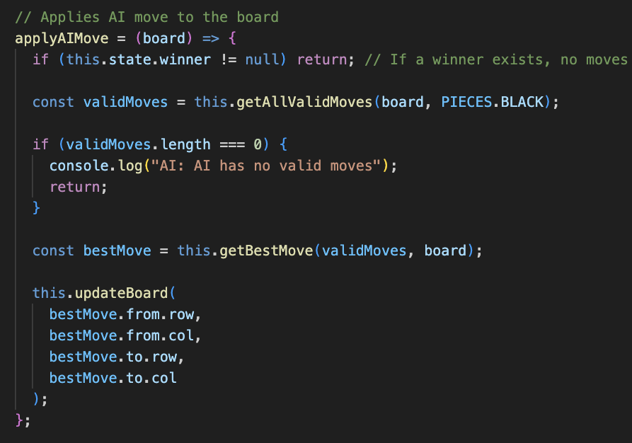
Function Highlight: applyAIMove
This function helps the game determine and apply the AI’s move.
It also uses several helper functions that will be shown in the next slide.
Notes:
Patrick

Slide 12
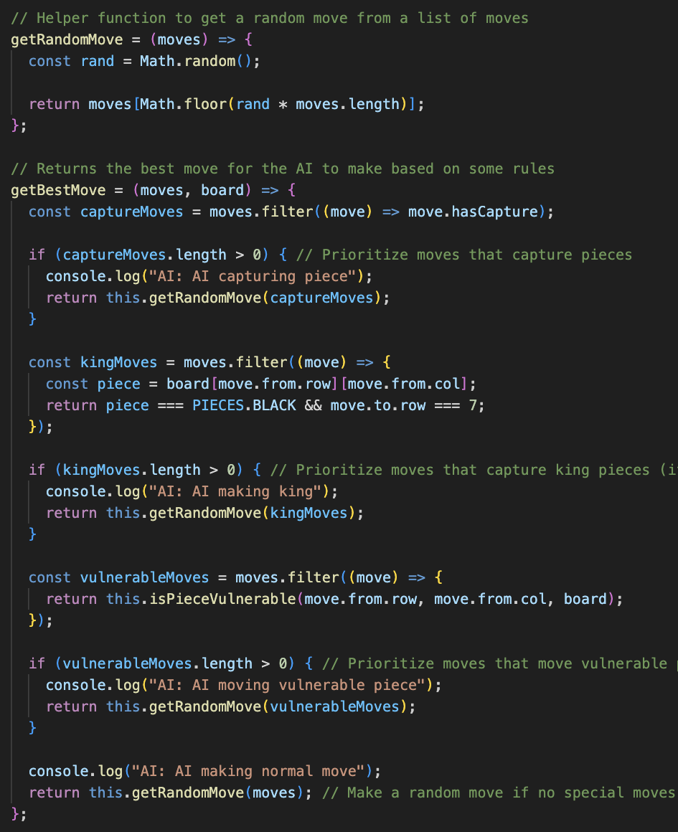
Function Highlight: applyAIMove - cont.
getRandomMove: gets a random move from a list of moves
getBestMove: determines the best move for the AI to make based on the following order:
1. Moves that capture another piece
2. Moves that make the piece into a king
3. Moves that move vulnerable pieces
4. Random
isPieceVulnerable (not displayed): determines if a piece is vulnerable by checking the opponent’s capturable moves
Notes:
Patrick

Slide 13
Misc. notes
Biggest challenge?
Coding the AI (looked at several different options)
Setting up VS Code - Sid had to use CodeHS and send Patrick his commits (until the very end)
What we would’ve added?
Color picker to the customization screen
Achievements / points system for customization
Who did what?
Fairly equal team effort
Called for a few nights to work on the project and discussed how to plan out code
Notes:
Patrick

Slide 14
Thank you!
https://github.com/patricksemler/checkers
Notes:
Patrick

